Slide 1
The relationship between economic development and female labour force participation: A within-country analysis of Mexico
Isaac Lopez Moreno Flores

Slide 2
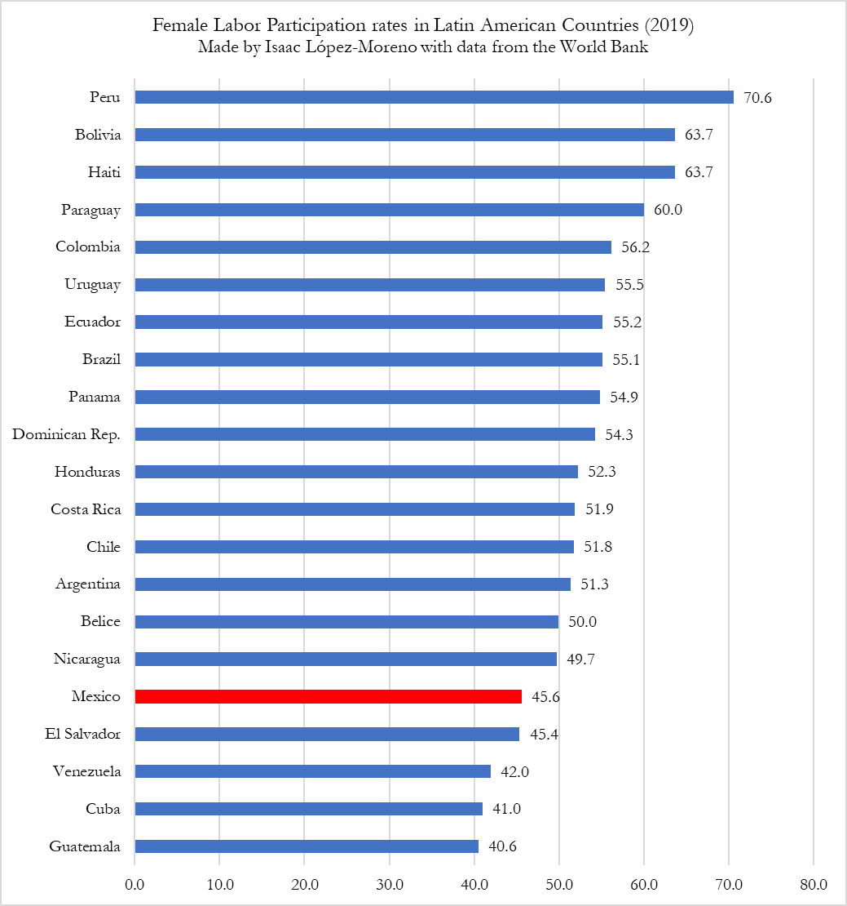
Research Problem
Mexico has one of the lowest female labour participation rates among Latin-American countries.

Slide 3
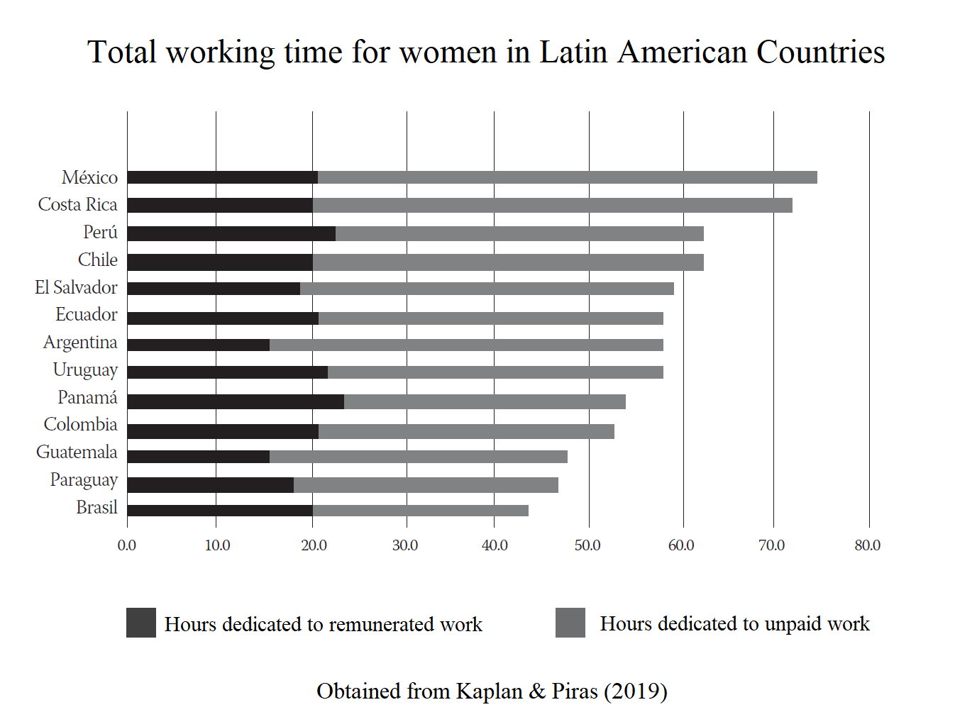
Research Problem
Moreover, Mexican women the ones who dedicate more time to unpaid work in the whole region.

Slide 4
Research Problem
On the other hand, Mexico is the Latin-American country with the highest percentage of jobs in the industrial sector.

Slide 5
Theory confirmation
Several researchers have confirmed Goldin’s theory:
Cagatay & Özler (1995)
Mammen & Paxson (2000)
Clark, York, and Anker (2003)
Luci (2009)
Tam (2011)
Verick (2014)
Heath & Jayachandran (2017)
However, most of these papers have different methodological errors.

Slide 7
The U-shaped feminization hypothesis
After a popular research paper written by Goldin (1995), the U-shaped relationship between economic development and women's labour force participation received a lot of attention.
According to this theory, FLPR are high in agricultural economies, they experience a decline in industrial economies, and they rise again in service-oriented economies.

Slide 8
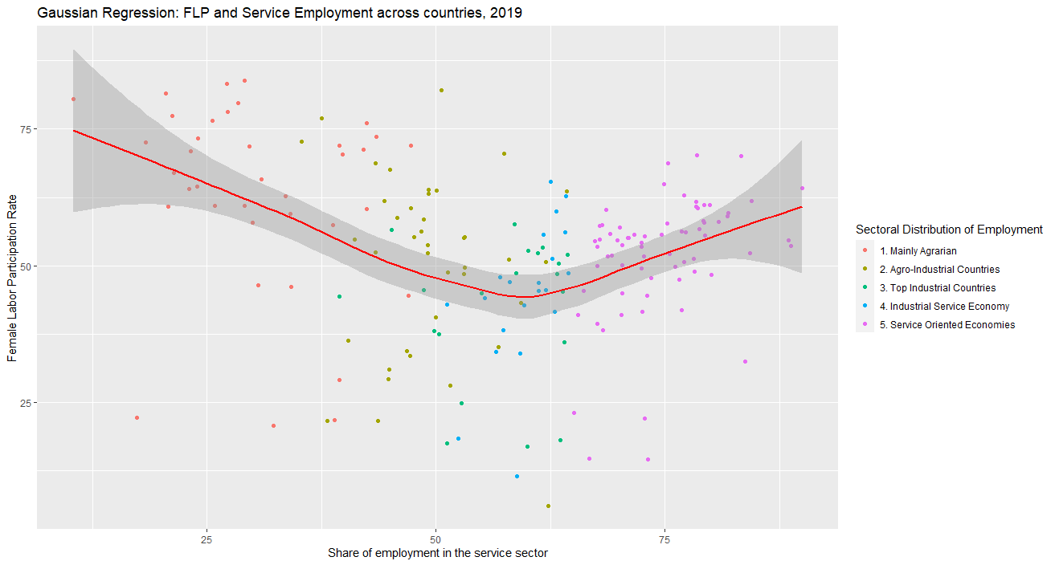
High FLPRs due to:
Dominant agricultural sector
Manual labour in agriculture
Lack of agricultural machinery
High labour demand
Low salaries and low productivity
Compatibility of FLPRs in family farms with child rearing
High fertility rates
High dependency ratio
y
X

Slide 9
Decline due to:
Expansion of the industrial sector
Several blue-collar jobs available
Social stigma towards married women in blue collar jobs
Strong Income effect
Weak substitution effect
Complex demand-effect driven by agricultural machinery
Gender gaps in education
Employers’ preferences or discrimination against women
Husbands’ or wives’ request to not engage in physically demanding jobs
Incompatibilty of FLP in industry + child rearing

Slide 10
Rise due to:
Expansion of the service sector.
Several white-collar jobs available
No social stigma towards white-collar jobs
Strong substitution effect Weak income effect
No gender gaps in education
Female achieved higher levels of education
Job flexibility
Lack of physically demanding jobs

Slide 12
